Slide 1
Molecular Genetics 2
From Gene to Protein

Slide 2
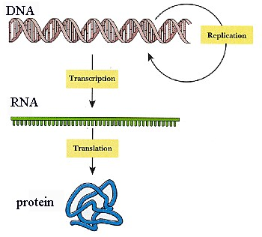
The Expression of Genes

Slide 3
I. RNA Links the Information in DNA to the Sequence of Amino Acids in Protein
a) Transcription is the mechanism by which a template strand of DNA is utilized by specific RNA polymerases to generate one of the three different classifications of RNA. These 3 RNA classes are:
1. Messenger RNAs (mRNAs): CODON - This class of RNAs carry the genetic code from the nucleus to ribosomes. The sequence of nucleotides in mRNA is a triplet code. Triplets of nucleotides code for specific amino acids which are incorporated into an elongating polypeptide in the process of translation.
2. Transfer RNAs (tRNAs): ANTICODON - This class of small RNAs form covalent bonds to individual amino acids. Transfer RNA transport amino acids from the cytoplasm to the ribosomes. They recognize the encoded sequences of the mRNAs to allow correct insertion of amino acids into the elongating polypeptide chain.
3. Ribosomal RNAs (rRNAs): This class of RNAs are assembled, together with numerous ribosomal proteins, to form the ribosomes.

Slide 4
b) RNA polymerase is a class of enzymes that catalyze RNA synthesis. They are dependent upon a DNA template to synthesize RNA.
The resultant RNA is complimentary to the template strand of the DNA duplex and identical to the non-template strand.
The non-template strand is called the coding strand because its' sequences are identical to those of the mRNA. However, in RNA, U (uracil) is substituted for T (thymine).

Slide 5
  c) Mechanism of RNA Polymerases
    Synthesis of RNA exhibits several features that are synonymous with DNA replication.
RNA synthesis requires accurate and efficient initiation, elongation proceeds in the 5' ---> 3' direction (i.e. the polymerase moves along the template strand of DNA in the 3' ----> 5' direction), and RNA synthesis requires distinct and accurate termination.
Transcription exhibits several features that are distinct from replication.
    1. Transcription initiates, both in prokaryotes and eukaryotes, from many more sites than replication.
        2. There are many more molecules of RNA polymerase per cell than DNA polymerase.
        3. RNA polymerase proceeds at a rate much slower than DNA polymerase (approximately 50-100 bases/sec for RNA versus near 1000 bases/sec for DNA).
        4. Finally the fidelity of RNA polymerization is much lower than DNA. This is allowable since the aberrant RNA molecules can simply be turned over and new correct molecules made.

Slide 6
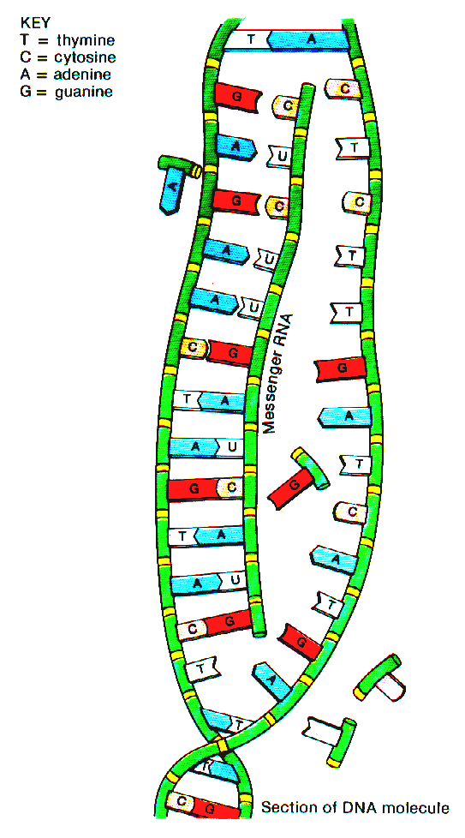
Transcription of RNA

Slide 7
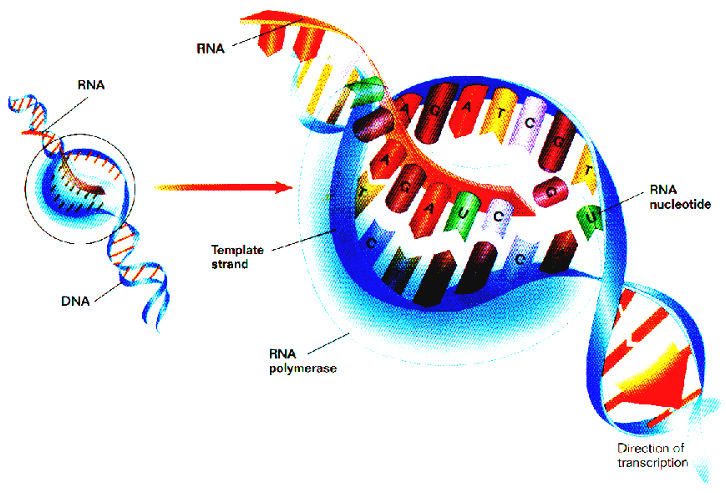
http://academy.d20.co.edu/kadets/lundberg/DNA_animations/protein.mov

Slide 8
  d) Processes of Transcription
        1. Signals are present within the DNA template that stimulate the initiation of transcription. These sequence elements are termed promoters.
        2. Promoter sequences promote the ability of RNA polymerases to recognize the nucleotide at which initiation begins.
Eukaryotic promoter sequences generally include a TATA box.

Slide 9
5. In eukaryotes, RNA polymerase initiates transcription at the promoter sequence.
6. Elongation involves the addition of the RNA nucleotides to the 3‘ end of the elongating RNA.
7. The addition of nucleotides continue until specific termination signals are encountered. Following termination the RNA polymerase detaches from the DNA template ready to initiate another round of transcription.

Slide 10
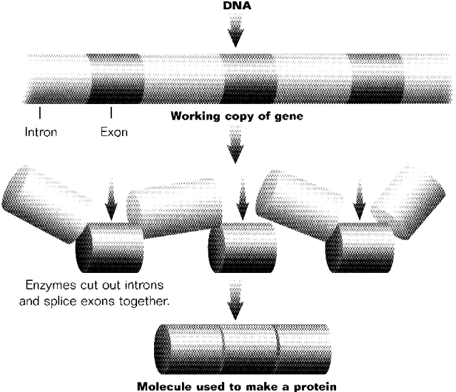
Post-Transcriptional Modification

Slide 11
f) Posttranscriptional Processing of RNAs
When transcription of bacterial rRNAs and tRNAs is completed they are immediately ready for use in translation.
In contrast to bacterial transcripts, eukaryotic RNAs (all 3 classes) undergo significant post-transcriptional processing.
All 3 classes of RNA are transcribed from genes that contain introns.
Introns are noncoding regions of eukaryotic genes, which are transcribed into mRNA but are then excised by a process called RNA-splicing by protein complexes known as spliceosomes.
The sequences encoded by the intronic DNA must be removed from the primary transcript prior to the RNAs being biologically active.

Slide 12
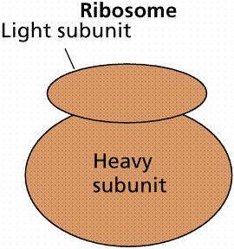
II. Protein Synthesis
a) Ribosomes are the organelle (in all cells) where proteins are synthesized.
They consist of two-thirds rRNA and one-third protein.
Subunits of a ribosome. Image from Purves et al., Life: The Science of Biology, 4th Edition, by Sinauer Associates (www.sinauer.com) and WH Freeman (www.whfreeman.com), used with permission.

Slide 13
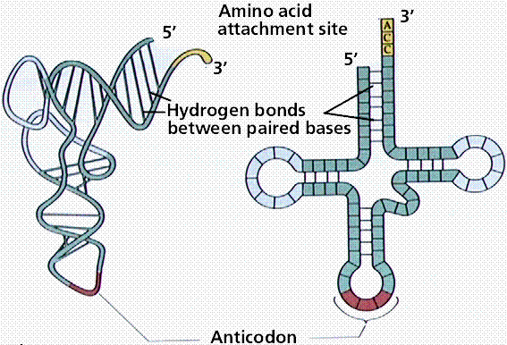
b) Transfer RNA (tRNA) is a cloverleaf-shaped molecule that carries the proper amino acid to the ribosome when the codons call for them.
Two Models of tRNA
Image from Purves et al., Life: The Science of Biology, 4th Edition, by Sinauer Associates (www.sinauer.com) and WH Freeman (www.whfreeman.com), used with permission.
At the top of the large loop are three bases, the anticodon, which is the complement of the codon.

Slide 14
There are 61 different tRNAs, each having a different binding site for the amino acid and a different anticodon.
For the codon UUU, the complementary anticodon is AAA.
Amino acid linkage to the proper tRNA is controlled by the aminoacyl-tRNA synthetases.
Energy for binding the amino acid to tRNA comes from ATP conversion to adenosine monophosphate (AMP).

Slide 15
c) Translation is the process of converting the mRNA codon sequences into an amino acid sequence.
The initiator codon (AUG) codes for the amino acid N-formylmethionine (f-Met).
No transcription occurs without the AUG codon (start codon) .
f-Met is always the first amino acid in a polypeptide chain, although frequently it is removed after translation.
The intitator tRNA/mRNA/small ribosomal unit is called the initiation complex.
The larger subunit attaches to the initiation complex. After the initiation phase the message gets longer during the elongation phase.

Slide 16
III. Translation: synthesis of protein by ribosomes
1. Anticodon: the 3 nucleotide sequence on t-RNA which the ribosome must fit against m-RNA to ensure that the correct amino acid is placed in the growing protein during translation.
2. Processes of Translation: Overview
Initiation: rRNA polymerase of ribosome binds to mRNA strand while the first tRNA is bonded to mRNA.
Elongation: Ribosome reads mRNA chain in three nucleotide groups (codon) & inserts 2nd tRNA.
tRNA anti-codon (with amino acid) binds to mRNA codon.
Translocation: 5' to 3' sequence continues building amino acid polymers (protein), one codon at a time.
Termination: tRNA recognizes release factors of nonsense codon. Newly completed polypeptide is released from ribosome.

Slide 17
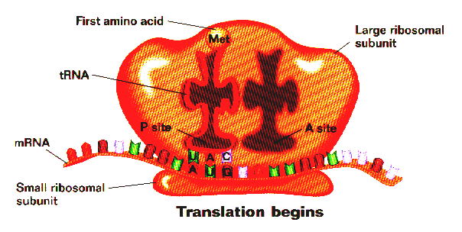
On all the diagrams below, the 5' end is at the left of the mRNA, the 3' end is at the right.
The ribosomes position themselves so that the codon sequence AUG (the "start" codon) on the mRNA is exposed. A tRNA unit with the anticodon sequence UAC bonds to the exposed "start" codon. This first tRNA only carries the amino acid methionine (met) which is now set in place.

Slide 18
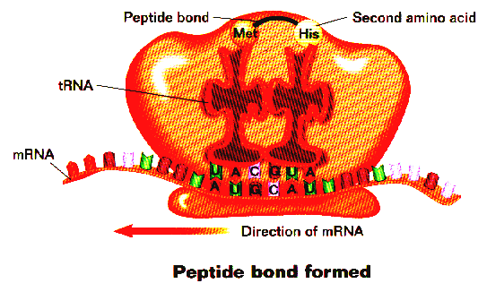
As the large ribosomal unit sets in place, the second codon on mRNA is exposed (in this case, the codon is CAU). This exposed site is known as the A site. At this point, a special protein unit known as the elongation factor assists the 2nd tRNA to bond to this newly exposed codon. The GUA of the antidodon (t RNA) bonds to the codon of CAU. At this point, the newly arrived amino acid (his) is lined up next to the 1st amino acid (met). An enzyme binds both amino acids via dehydration synthesis (loss of water) bonding.

Slide 19
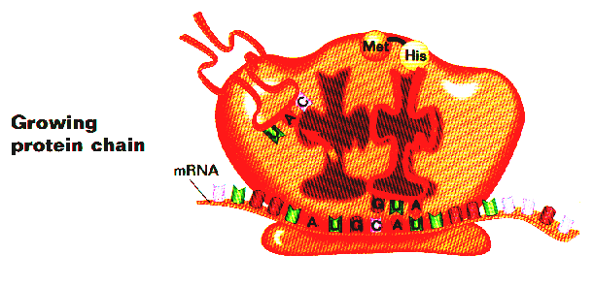
When the 1st two amino acids are bonded, the first tRNA leaves the mRNA/ ribosomal complex.

Slide 20
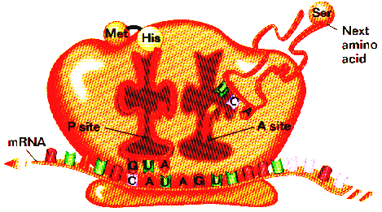
Translocation: In this step, the ribosomal unit physically moves (translocates) 3 bases (a new codon: AUG) along the mRNA in the 5' ---> 3' direction. When the new codon is exposed, another elongation protein assists the new tRNA and its associated amino acid (Ser) to bind to the codon. After this occurs, an enyme binds the amino acids His and Ser via dehydration synthesis.

Slide 21
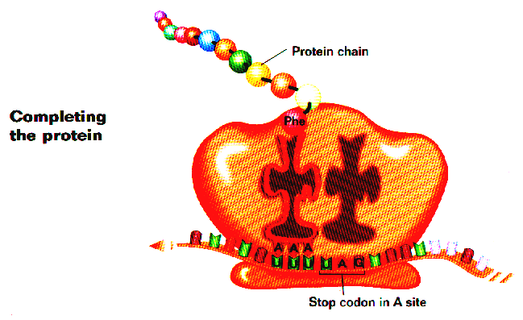
Termination: The end of the translation process.
The diagram above illustrates the ribosomal complex after it has been translocated down the mRNA many codon sequences. The ribosome has constantly read the mRNA in the 5' ---> 3' direction. The result is a growing chain of amino acids, all bonded together to make a polypeptide chain.

Slide 22
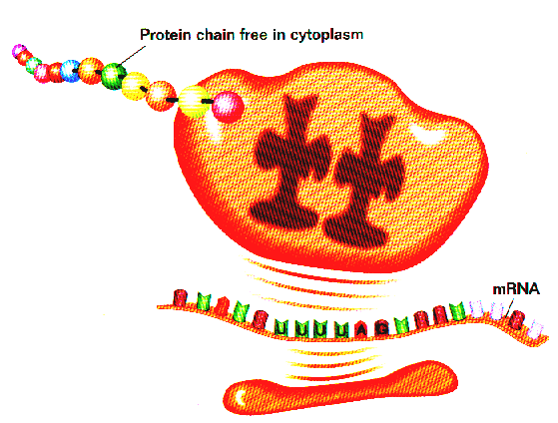
When a codon with the nonsense sequence UAA, UAG (seen here), or UGA is exposed, that is a signal that translocation is to stop.
The stop codon is not bonded to a complementary anticodon sequence on a tRNA. Rather, a protein known as a release factor binds at the A site. The release factor ultimately will help release the finished polypeptide chain in the next step.
The release factor (not shown in this diagram) prevents further reading of the mRNA message. The polypeptide molecule is released from the ribosomal units. The mRNA and the large and small ribosomal units are thus free to begin the translation process again.

Slide 23
IV. The Genetic Code: Translation of RNA code into protein
a) The code consists of three bases.
To code for the 20 essential amino acids a genetic code must consist of at least a 3-base set (triplet) of the 4 bases.
If one considers the possibilities of arranging four things 3 at a time (4X4X4), we get 64 possible code words, or codons (a 3-base sequence on the mRNA that codes for either a specific amino acid or a control word).
b) The genetic code was broken by Marshall Nirenberg and Heinrich Matthaei, a decade after Watson and Crick's work.

Slide 24
c) The genetic code consists of 61 amino-acid coding codons and three termination codons, which stop the process of translation.
The genetic code is thus redundant (degenerate in the sense of having multiple states amounting to the same thing), with, for example, glycine coded for by GGU, GGC, GGA, and GGG codons.
If a codon is mutated, say from GGU to CGU, is the same amino acid specified?

Slide 25
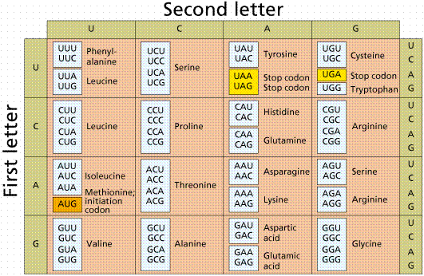
The genetic code. Image from Purves et al., Life: The Science of Biology, 4th Edition, by Sinauer Associates (www.sinauer.com) and WH Freeman (www.whfreeman.com), used with permission.

Slide 26
V. Mutations Redefined
Mutations were previously defined as any change in the DNA.
b) New Definition: A mutation is a change in the DNA base sequence that results in a change of amino acid(s) in the polypeptide coded for by that gene.
c) Alleles are alternate sequences of DNA bases (genes), and thus at the molecular level the products of alleles differ (often by only a single amino acid, which can have a ripple effect on an organism by changing ).
d) Addition, deletion, or addition of nucleotides can alter the polypeptide.
Point mutations are the result of the substitution of a single base.
Frame-shift mutations occur when the reading frame of the gene is shifted by addition or deletion of one or more bases.

